Slide 1
Scientific Drawing
Draw what you see!

Slide 3
Accurate
BIG
Colorful
Detailed
Explanation

Slide 4
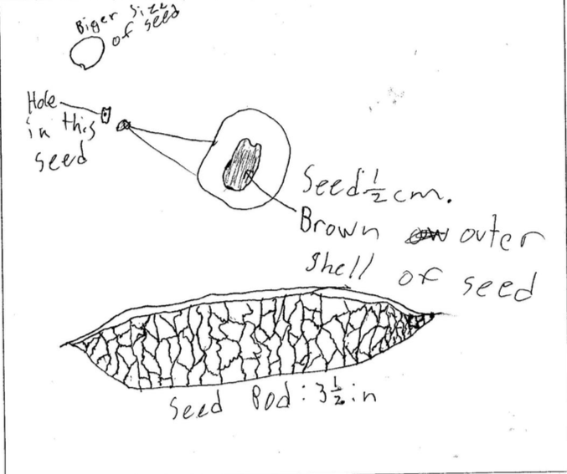

Slide 5
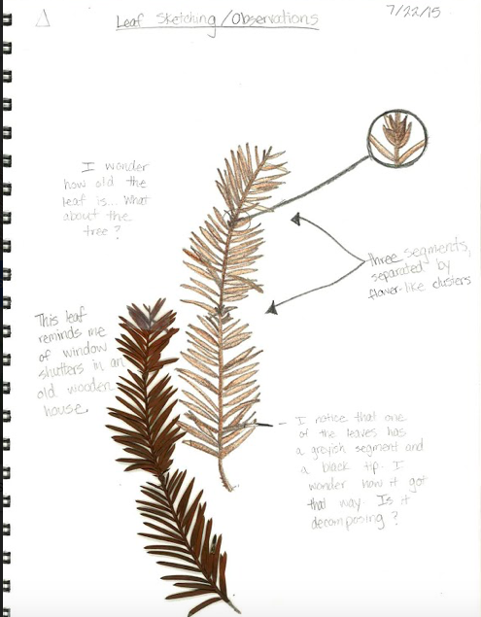
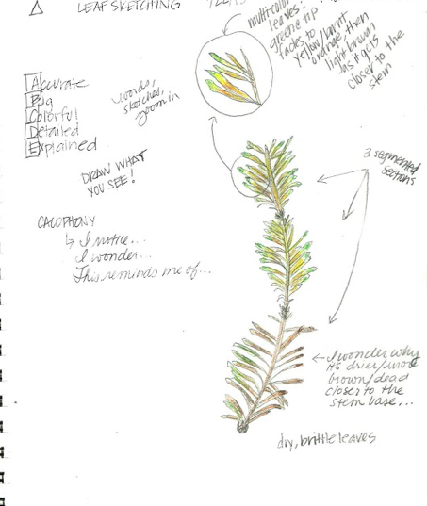

Slide 6
Lewis and Clark
No. 27. taken 4th of August, and furst observed at the bald prarie -- it is beatifull plant with a variagated leaf -- these leaves incompass the flowers which are small and in the center of them; at a small distance they resemble somewhat a white rose the leaf near the large stem is green and is edged with white; they grow smaller and more numerous as they approach the flower or the extremity of the limb. the plant is much branched; the leaf is smoth on both sides and edge, of an ovate form and pale green colour, rises to five or six feet, is annual at every point that it branches it has a pair of opposite leaves and from thee to four branches -- - Meriwether Lewis

Slide 7
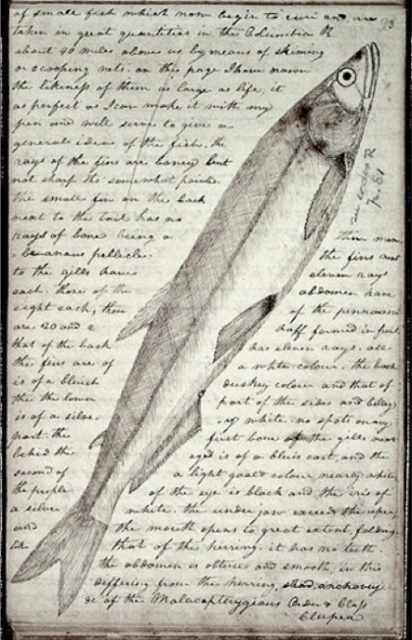

Slide 8
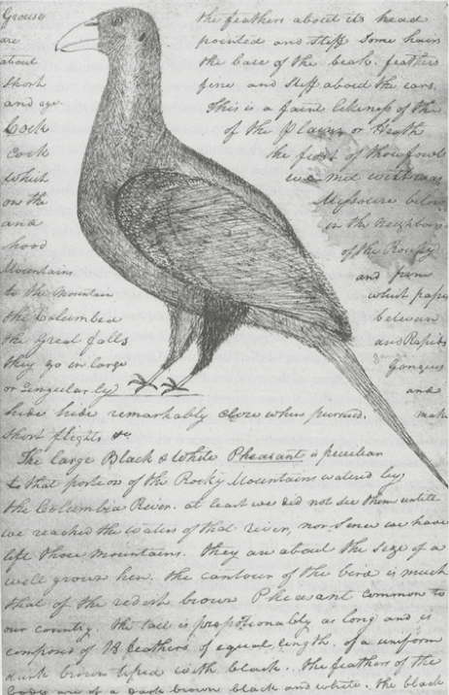
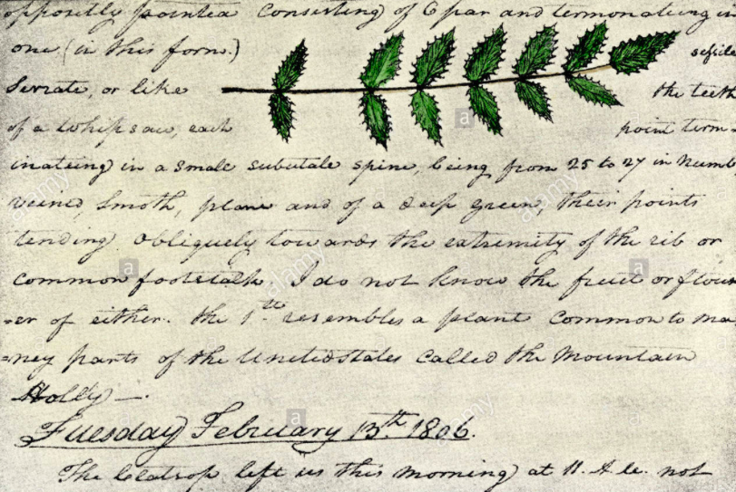

Slide 9
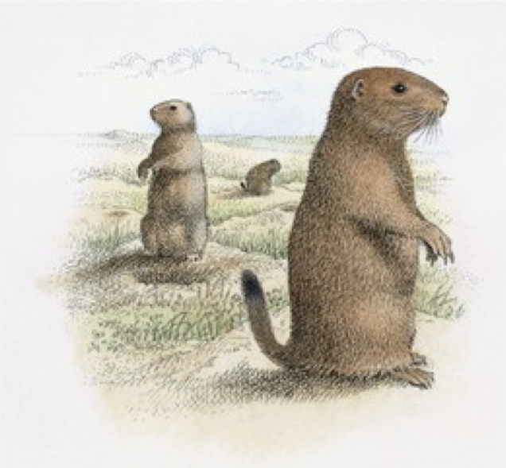
Clark — Friday, September 7, 1804 "Discovered a Village of Small animals that burrow in the grown (those animals are Called by the french Petite Chien) Killed one and Caught one a live by poreing a great quantity of Water in his hole we attempted to dig to the beds of one of those animals, after digging 6 feet [1.8 meters], found by running a pole down that we were not half way to his Lodge... The Village of those animals Covd. about 4 acres [1.6 hectares] of Ground on a gradual decent of a hill and Contains great numbers of holes on the top of which those little animals Set erect, make a Whistleing noise and whin allarmed Step into their hole. we por’d into one of those holes 5 barrels of Water without filling it. Those Animals are about the Size of a Small Squ[ir]rel... except the ears which is Shorter, his tail like a ground squirel which they shake & whistle when allarmd. the toe nails long, they have fine fur."

Slide 10
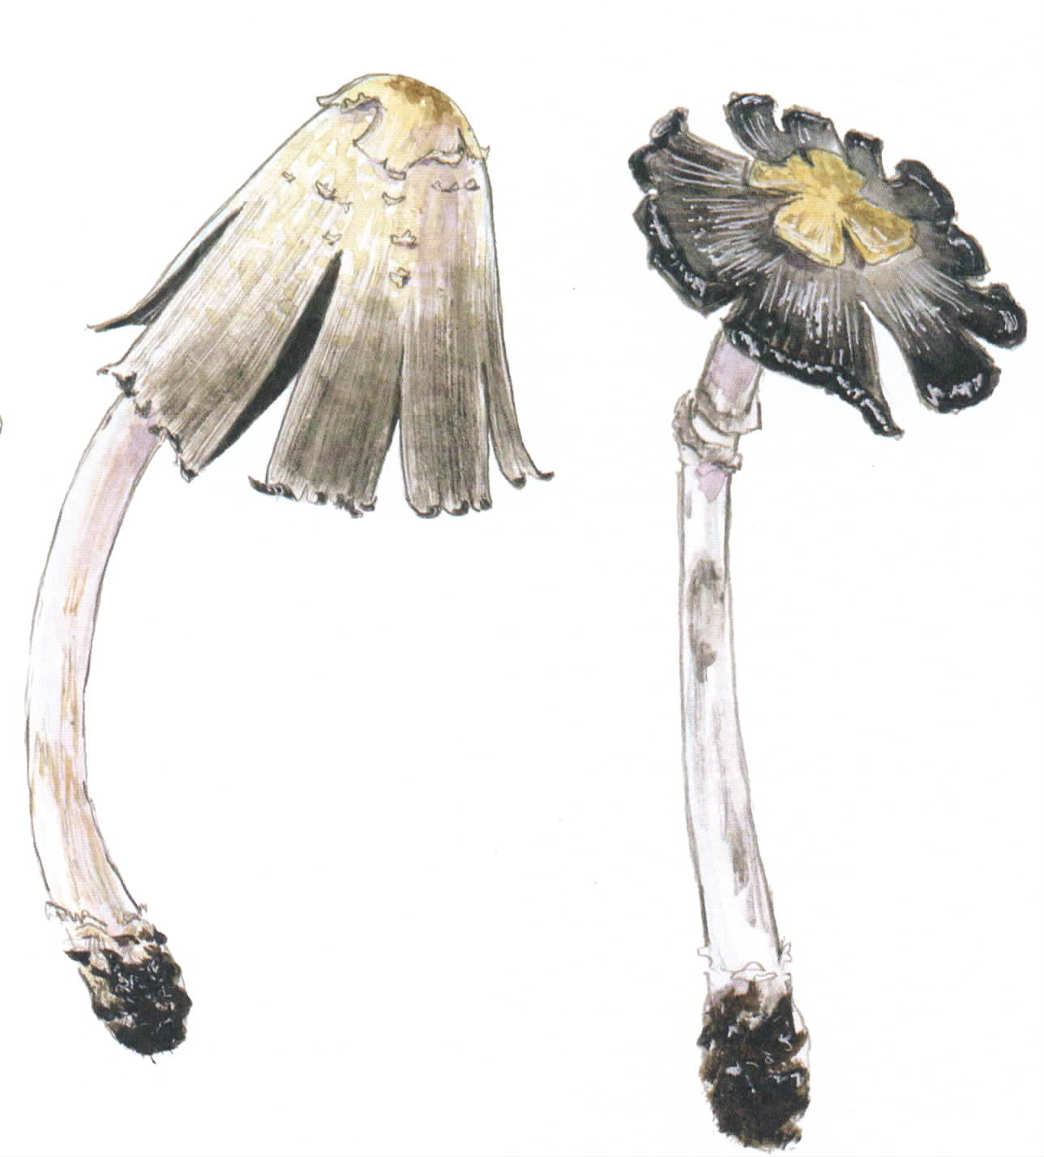
Observe first
Look at what you’re drawing
Fill the whole page
Add many details
Use insets for small details / magnified areas
Measure dimensions
Label and describe

Slide 11
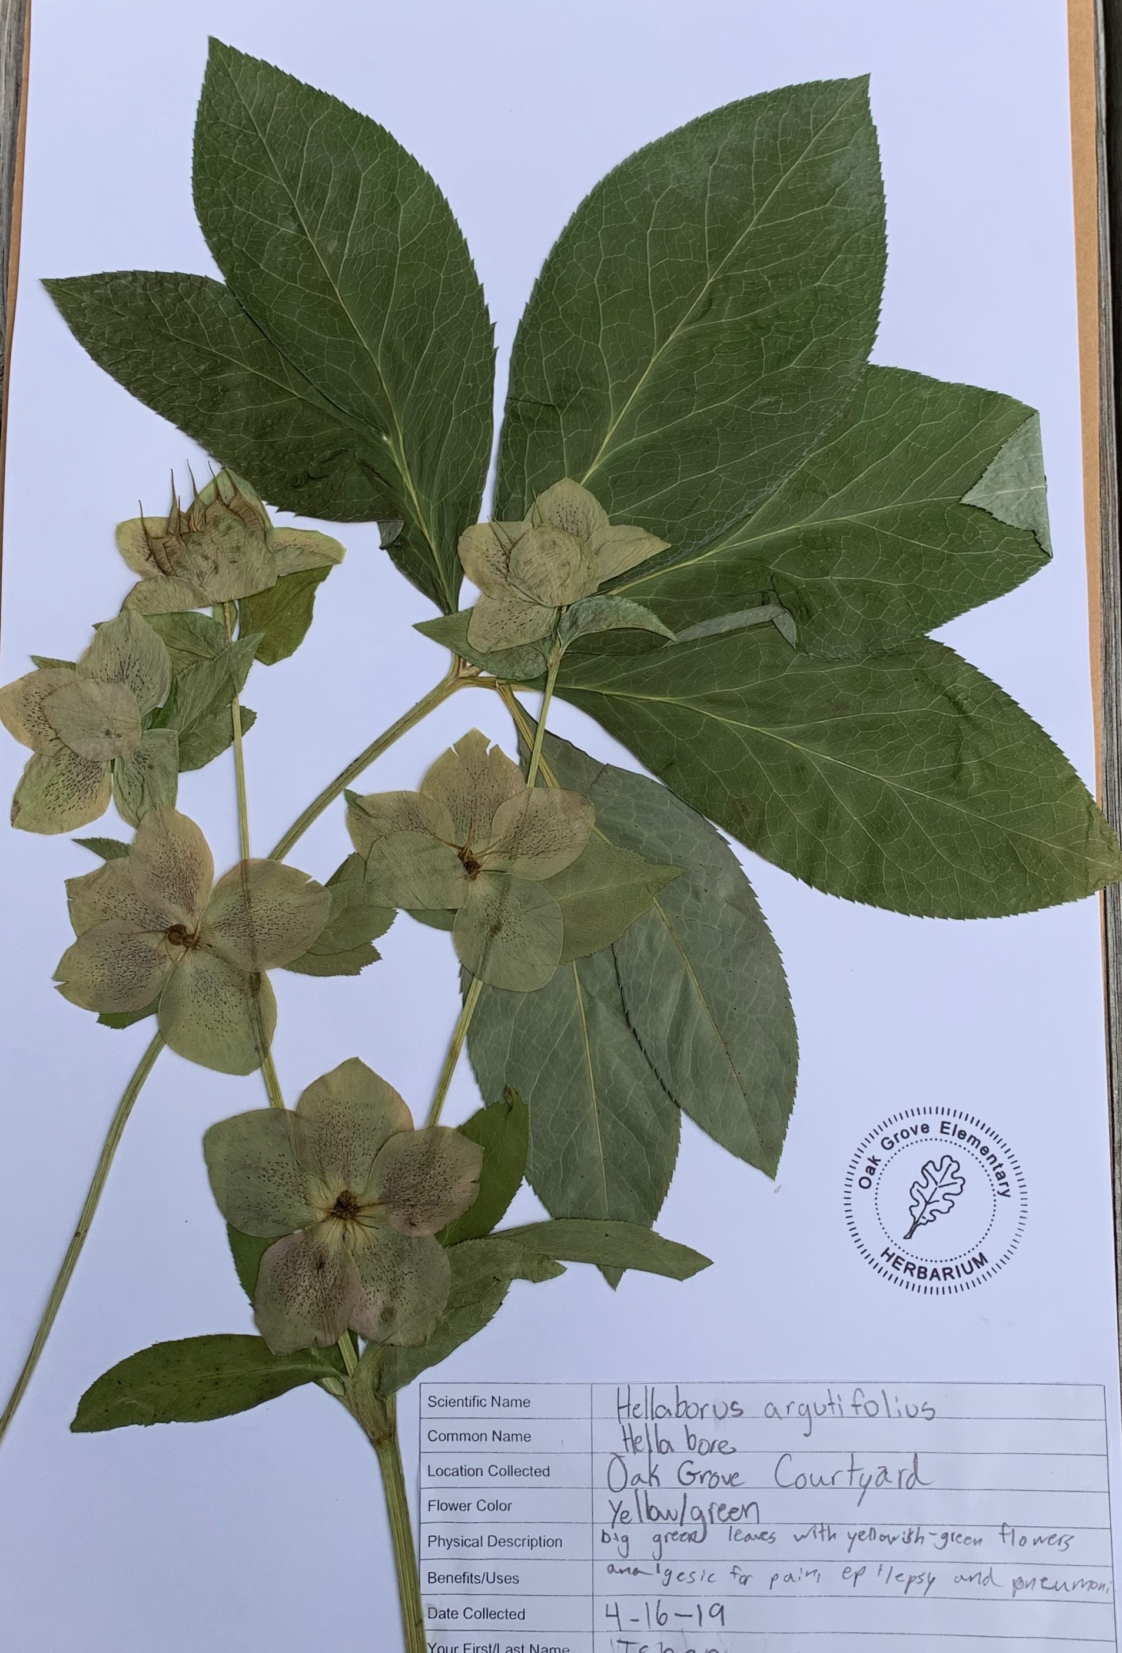
Herbarium Specimens

Slide 12
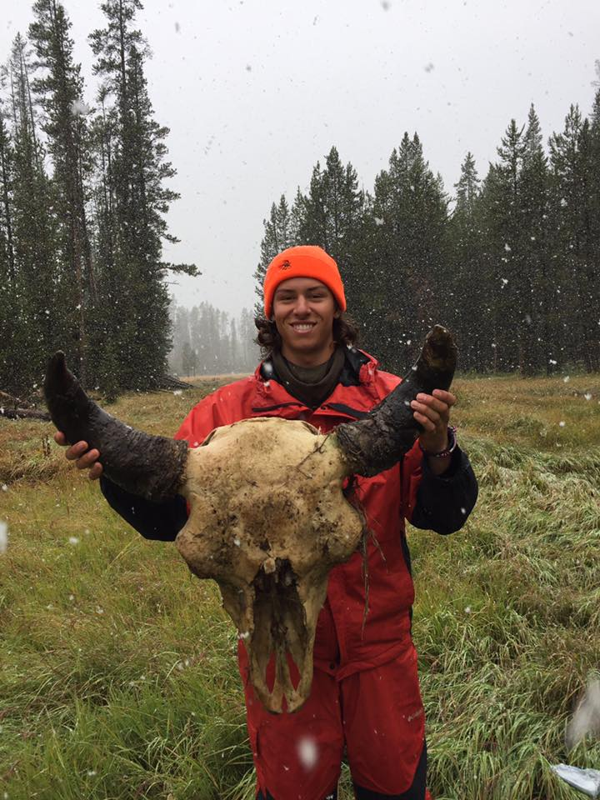
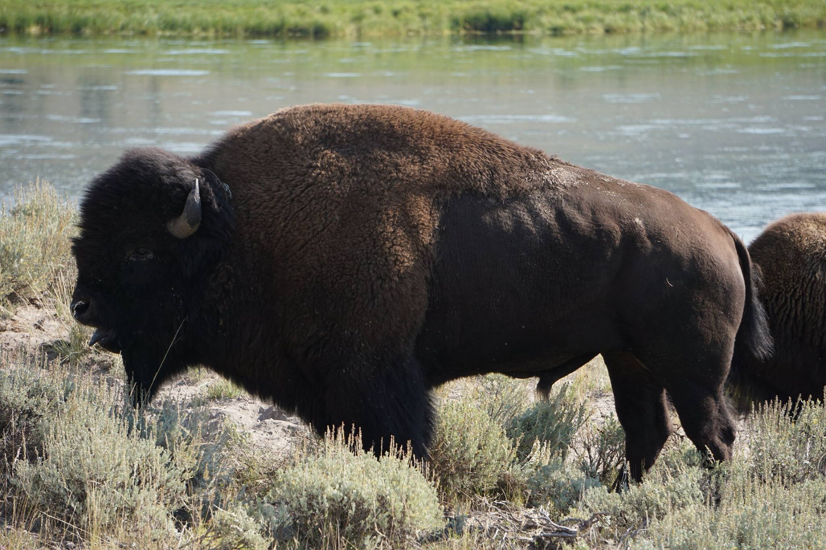
Taxidermy
Yellowstone
National
Park

Slide 13
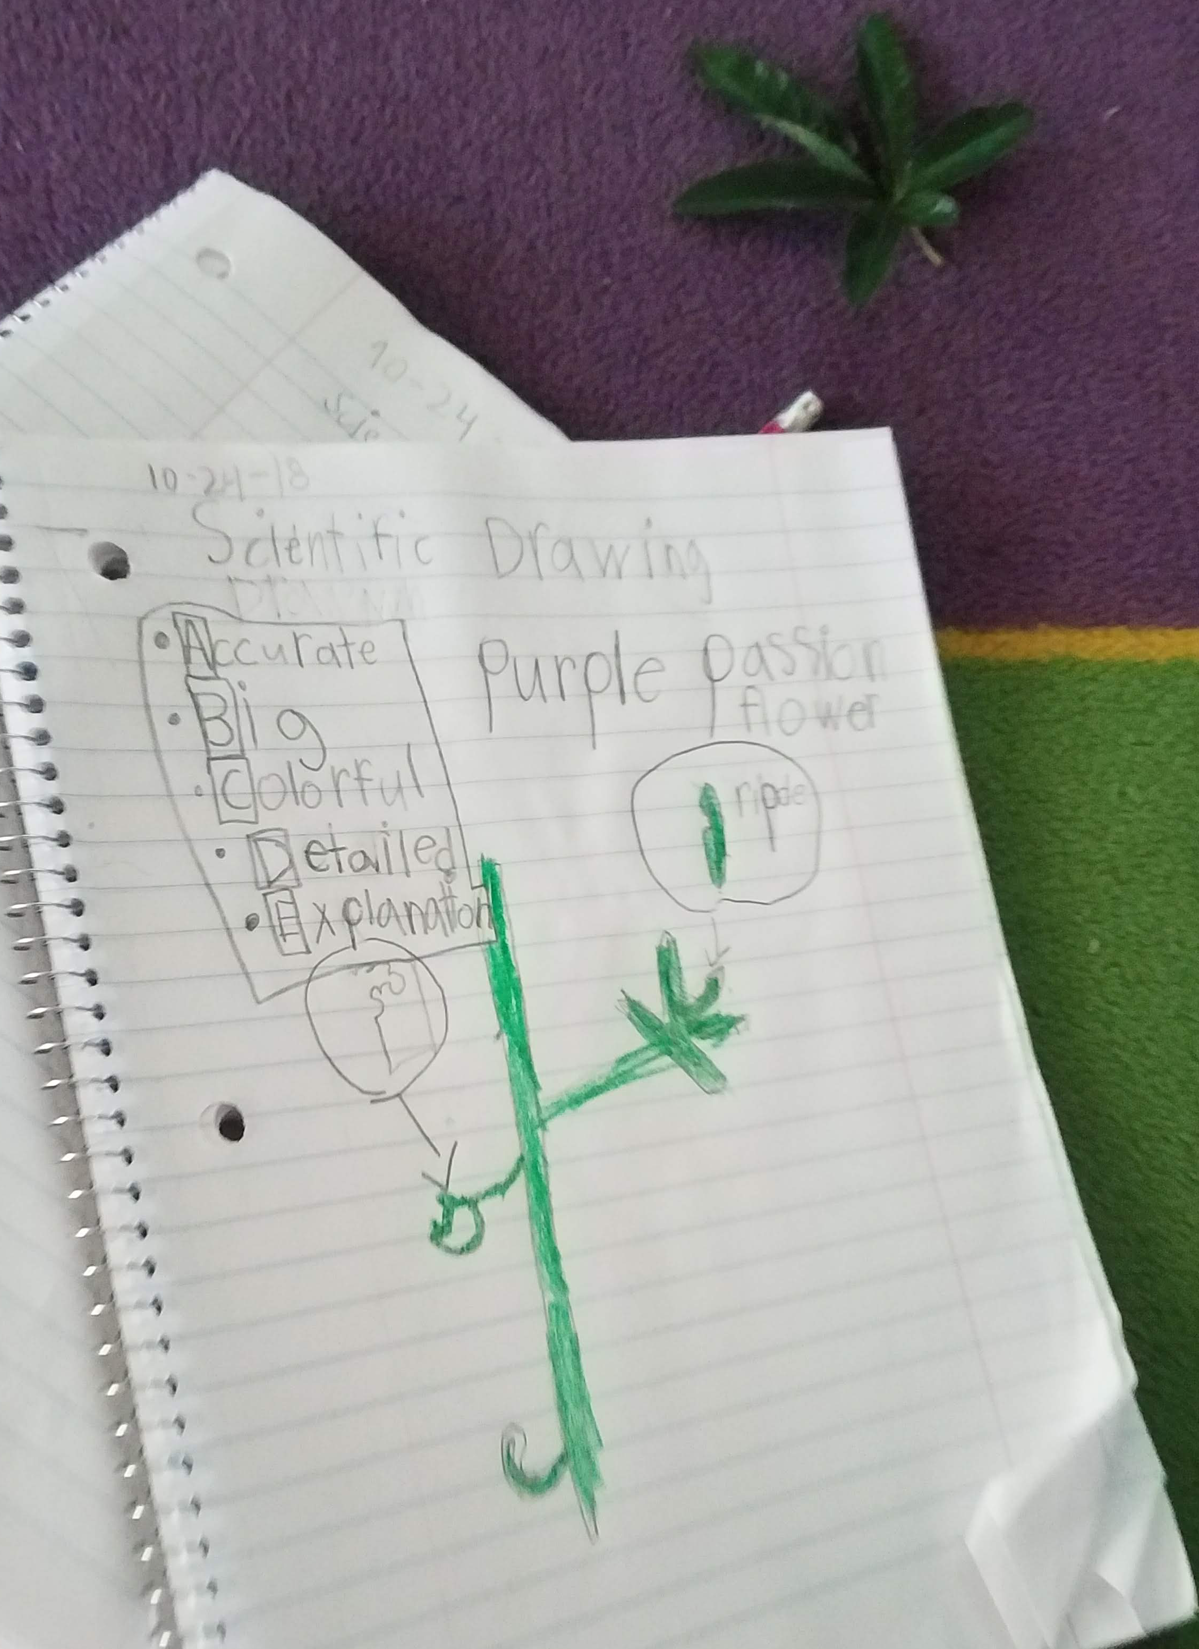
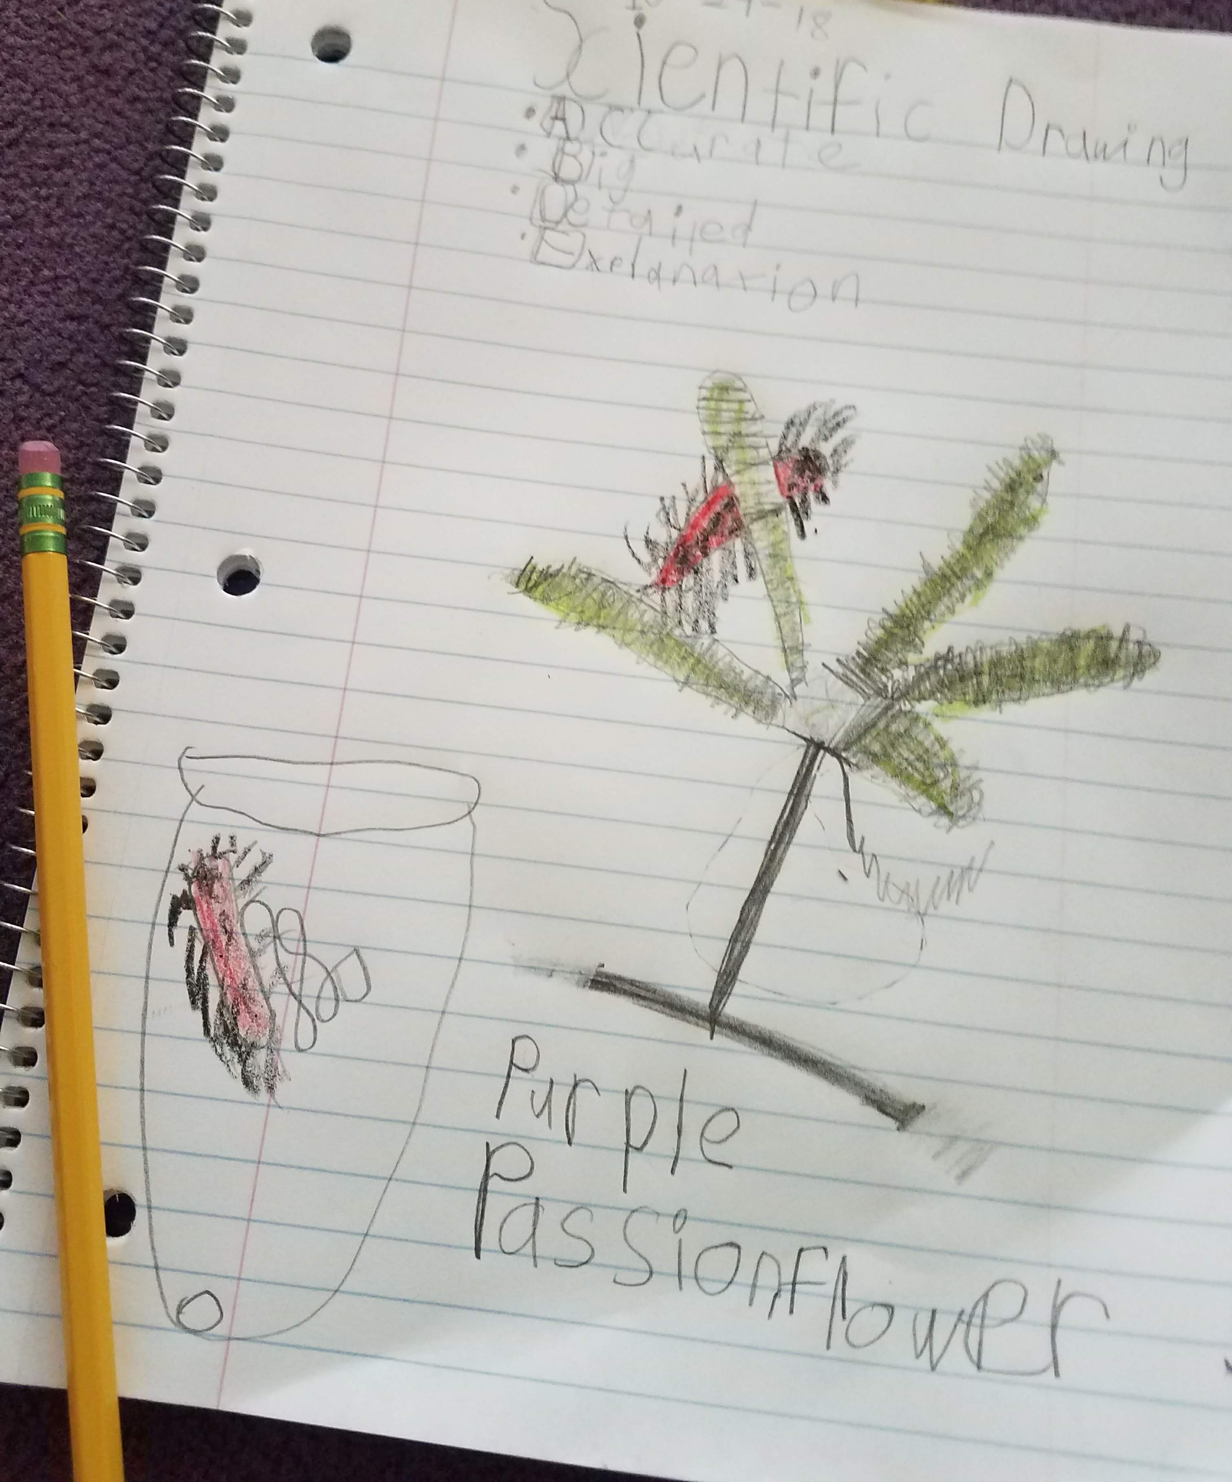
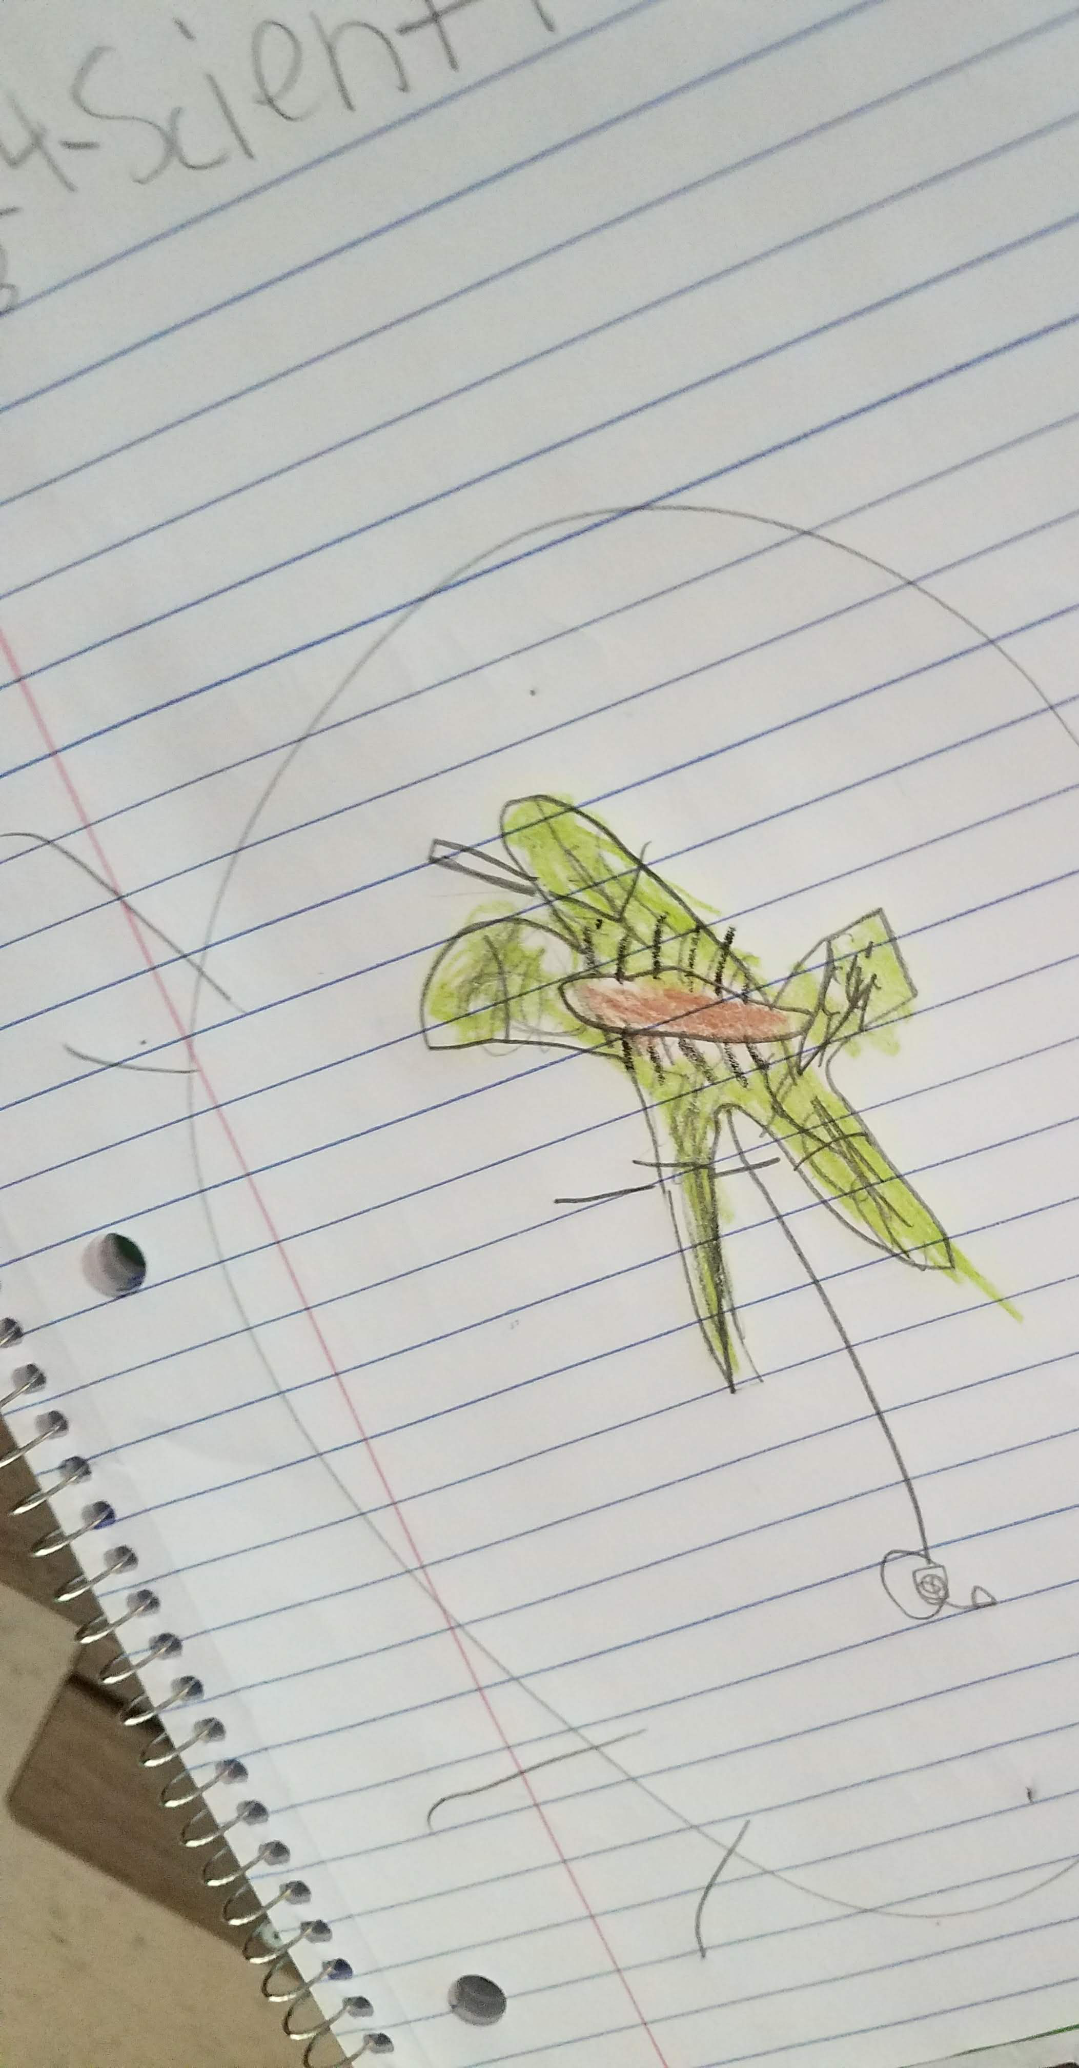
Scientific Drawings of the Passion Flower Leaf
by Oak Grove students

Slide 14
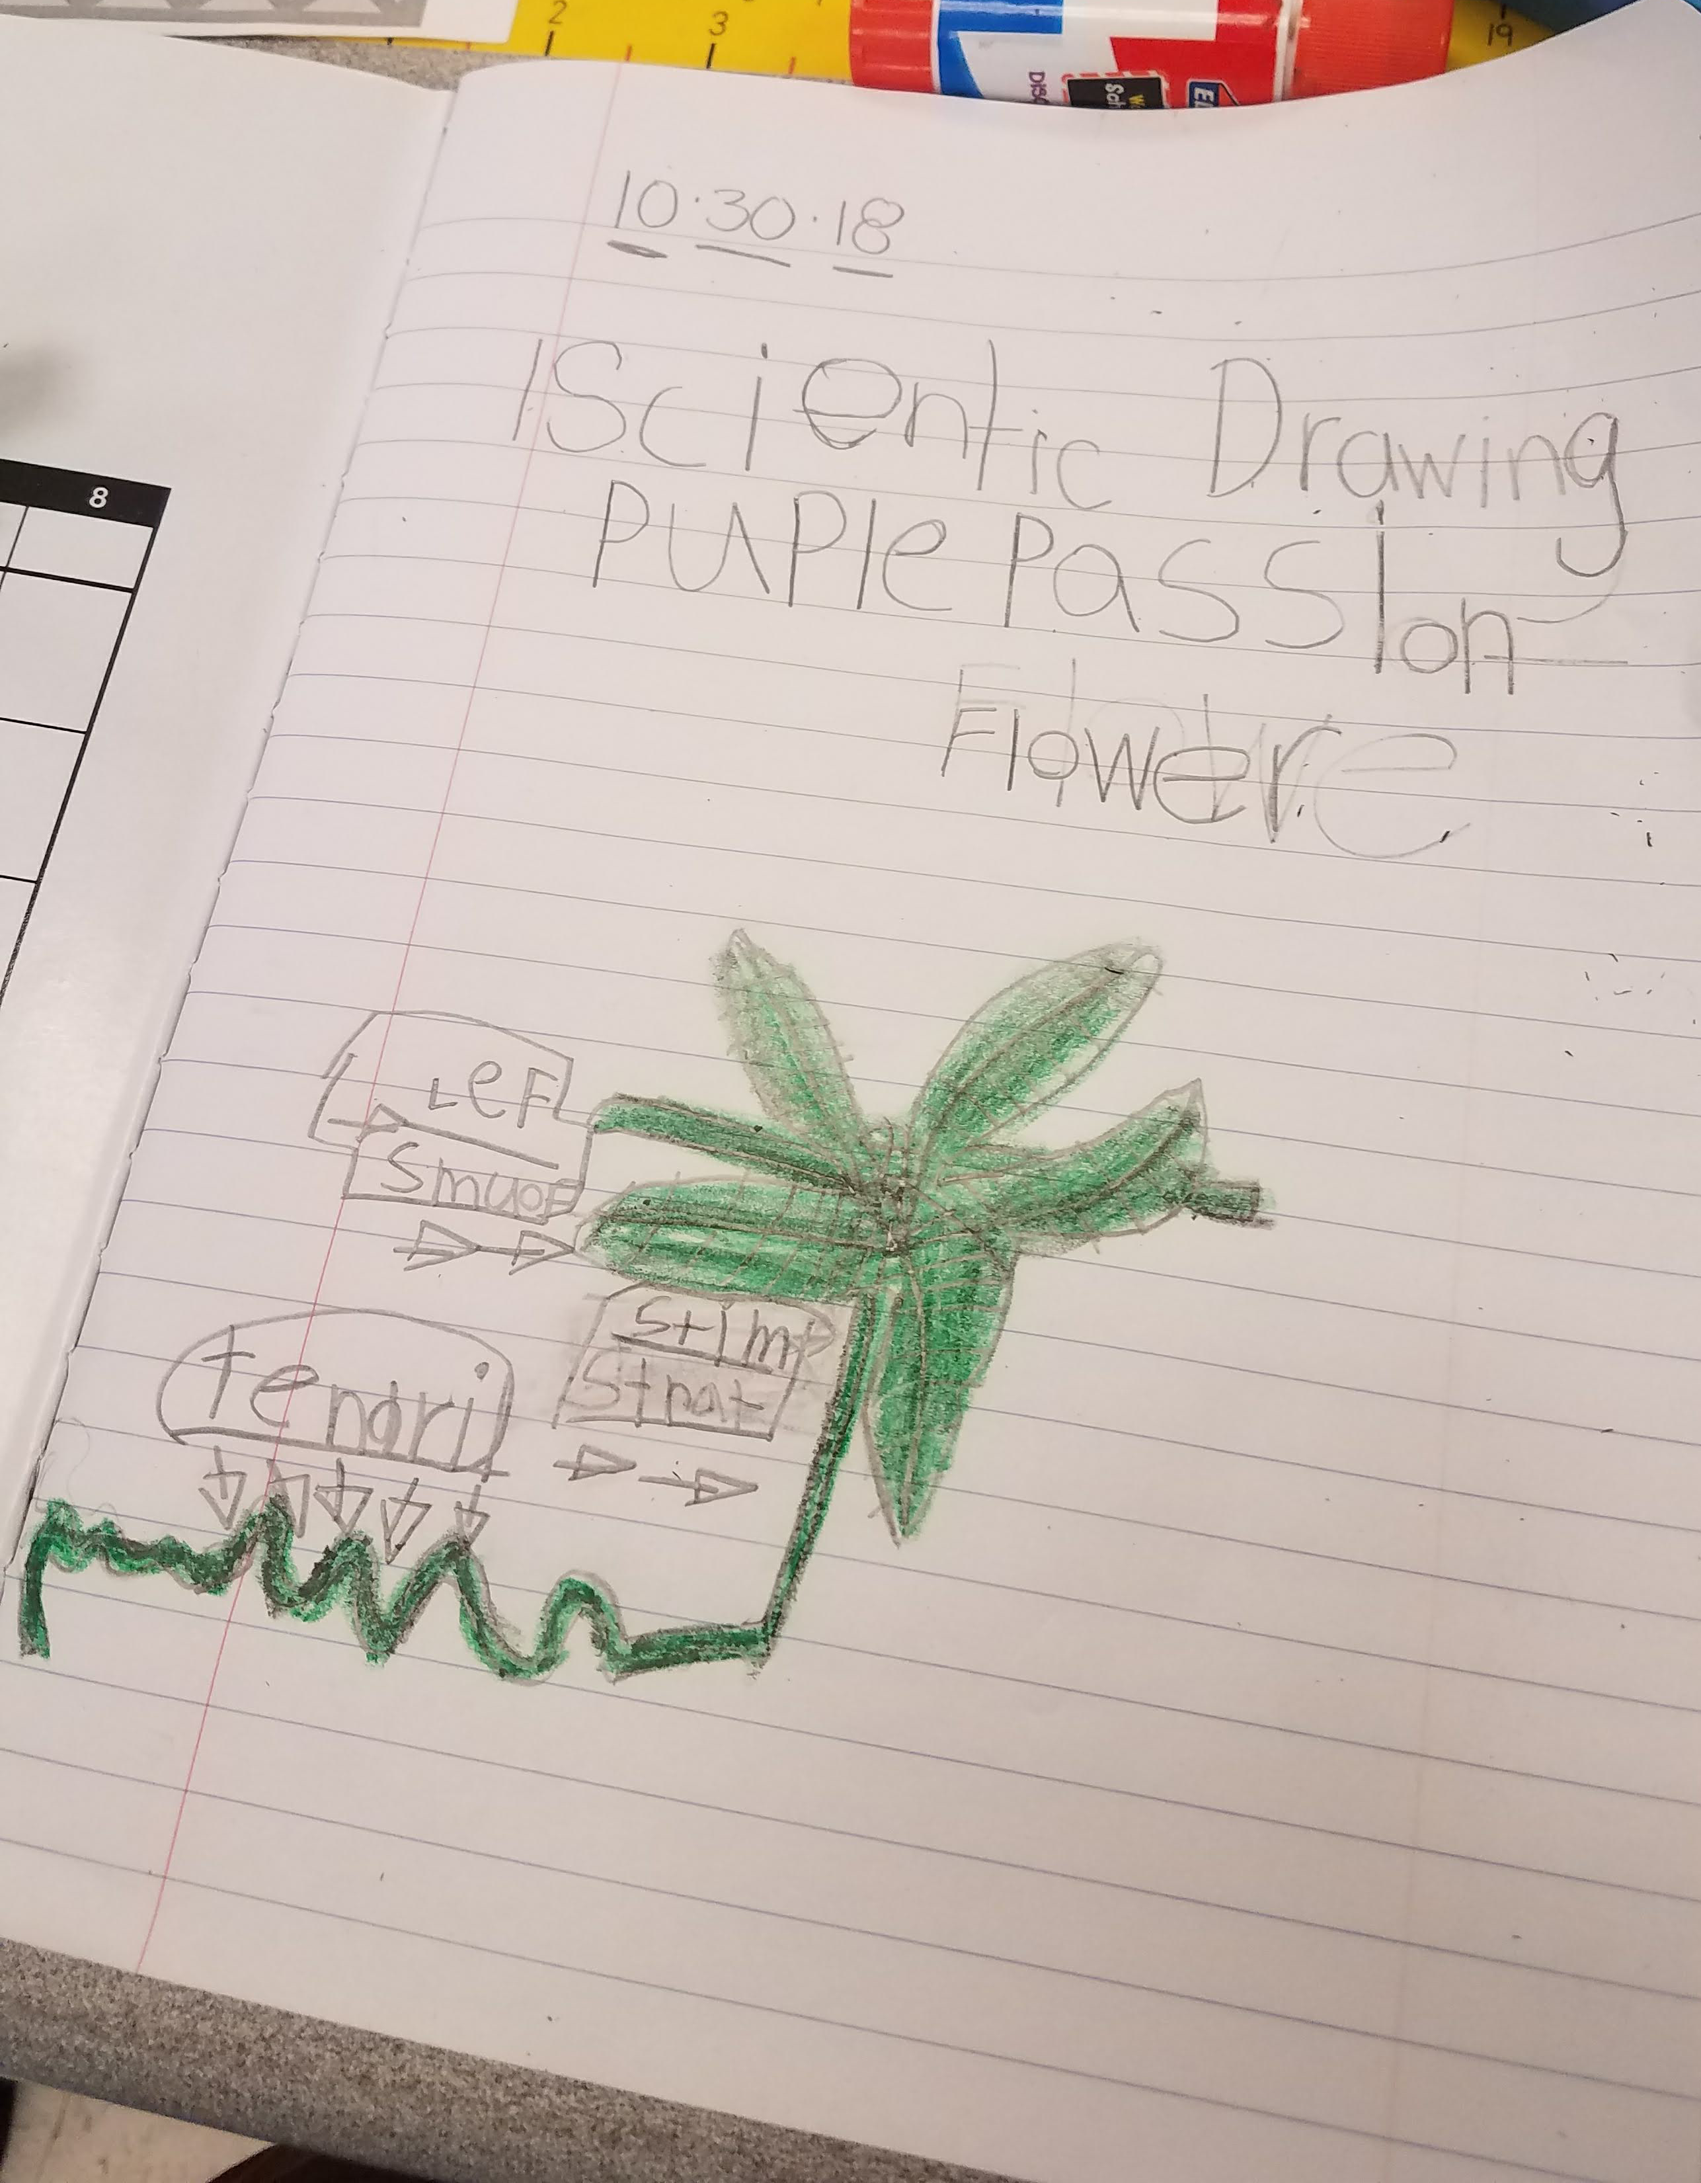
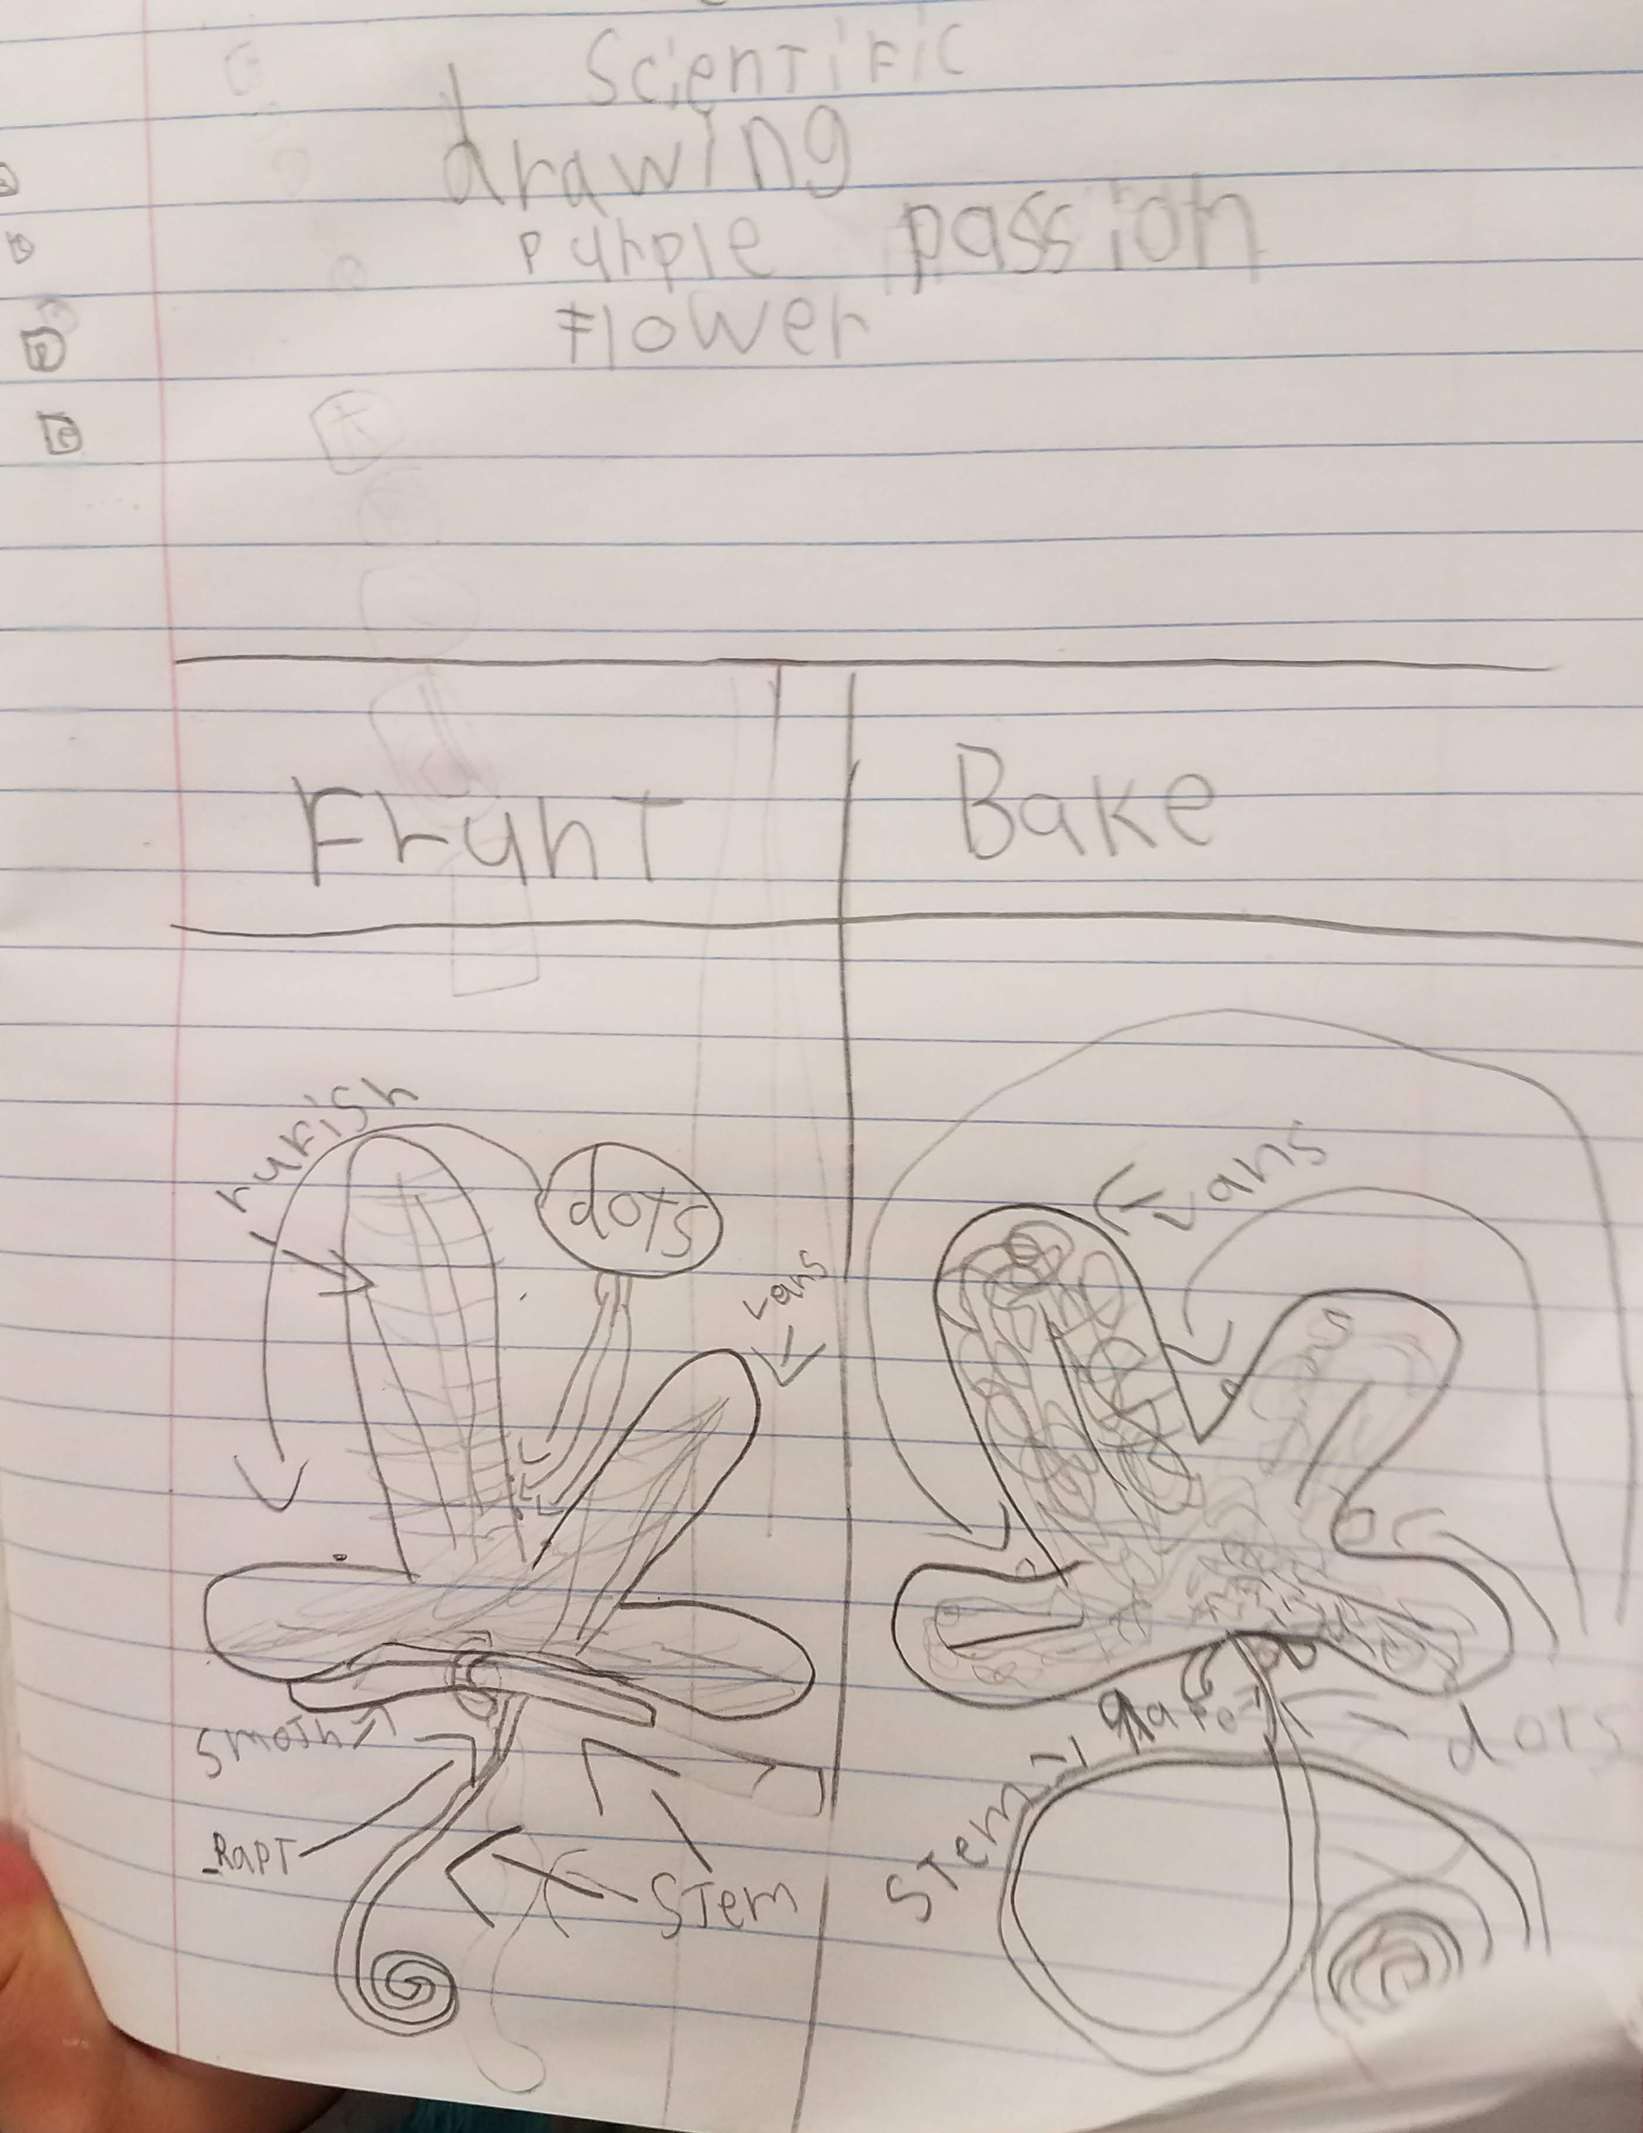
Accurate
BIG
Colorful
Detailed
Explanation
These drawings have good details and explanations

Slide 15
REMEMBER
Draw what you see!

